Slide 1

Doctor of Education
Doctoral Thesis Outline Plan & Implementation
4 YEAR PLAN

Slide 2
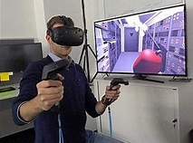
virtual reality
AND
MEntal health

Slide 3
Why do it?
I want to undertake this research because I was helped by virtual reality myself in a remarkable way. After three years of suffering from anxiety issues ,after only a few days of using a virtual reality headset , my acute anxiety had gone! There is no available treatment centres in my area , after suitable accredited virtual reality training , I would like to open a clinic to help other people like myself. The patient would be asked if they would like to take part in research , and the standard NHS questionnaire (PHQ-9) would be used before treatment and after treatment. This data would be subject to statistical analysis and be the basis of the doctoral thesis. Furthermore patterns will be looked for to propose a possible psychological mechanism for virtual reality therapy. I would also want to train to a high level to become expert in virtual reality therapy treatments and understanding the mechanism. Also, I would like to attend international conferences to share my findings with colleagues around the world. In the future I would also like to educate the general public and interested parties in my research findings.

Slide 4

What is virtual Reality therapy?
Patient wears a Virtual Reality Headset and is exposed to scenarios that cause anxiety in their normal everyday life, Repeated exposure to these scenarios desensitizes the brain to the anxiety causing trigger.

Slide 5

Year 1
VIRTUAL REALITY THERAPY TRAINING
OPEN VIRTUAL REALITY THERAPY CLINIC CHESTER 2026
ACCREDITED HOMEOPATH & MEMBER OF THE FEDERATION OF HOLISTIC THERAPISTS
COLLECT PATIENT QUESTIONNAIRE USING NHS FORM PHQ-9
Patient Health Questionnaire (PHQ-9)
THIS DATA FROM PHQ-9 WILL FORM THE BASIS OF THE RESEARCH
INTERNATIONAL VIRTUAL REALITY THERAPY CONFERENCES 2026

Slide 6

Year 2
VIRTUAL REALITY EDUCATIONAL TALKS t.
The access to VR Therapy amongst the target population i.e. those suffering from mental health problems, is not well known.
The way to overcome this is to give presentations to NHS trusts to “spread the word”
Secondly , this can be also be widened to the general population as 1 in 5 people suffer from mental health problems most people know someone suffering in this way,

Slide 7

Year 3
VISITS TO VR THERAPY CLINICS
VISITS TO UNIVERSITIES
UNDERTAKING VR THERAPY RESEARCH
OPEN TRIAL OF VR THERAPY TO VOLUNTEERS
REPORT FINDINGS TO BE INCLUDED IN THESIS

Slide 8
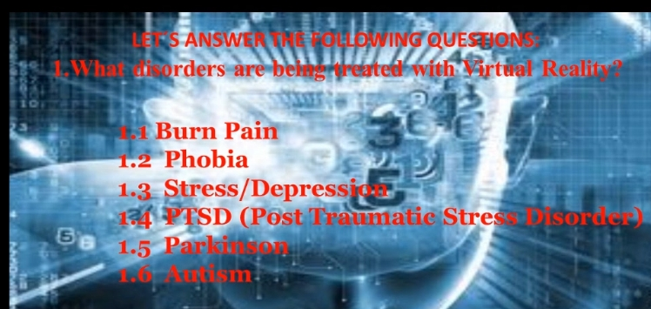
Which disorders are being treated by vr?

Slide 9
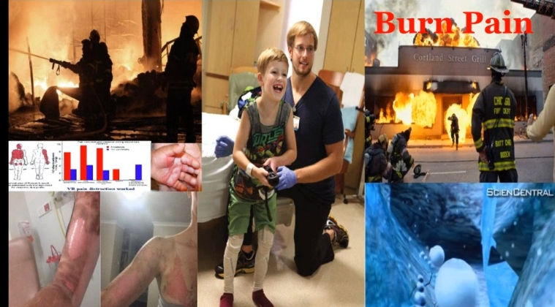
Dr Nicole Gibran Washington

Slide 10
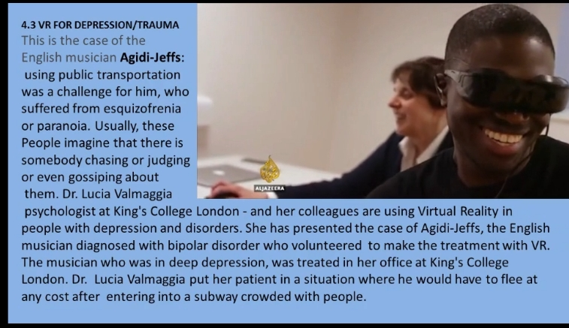
Depression vr therapy

Slide 11
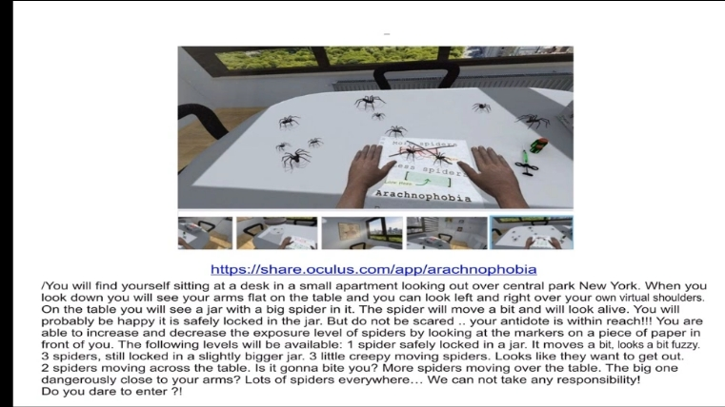
arachnophobia

Slide 12
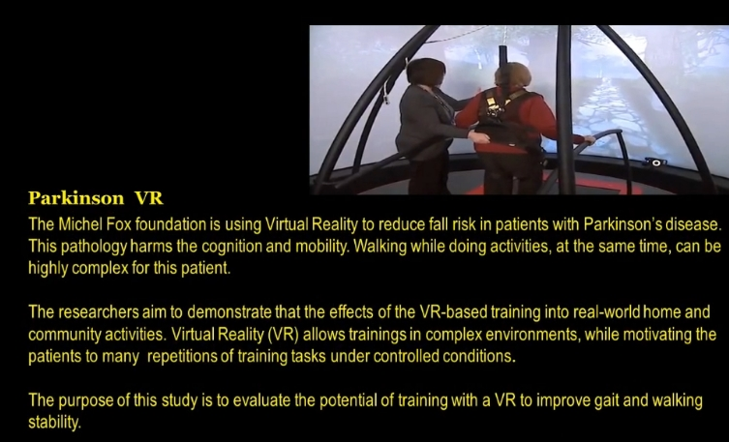
Vr therapy for treating Parkinson’s

Slide 13
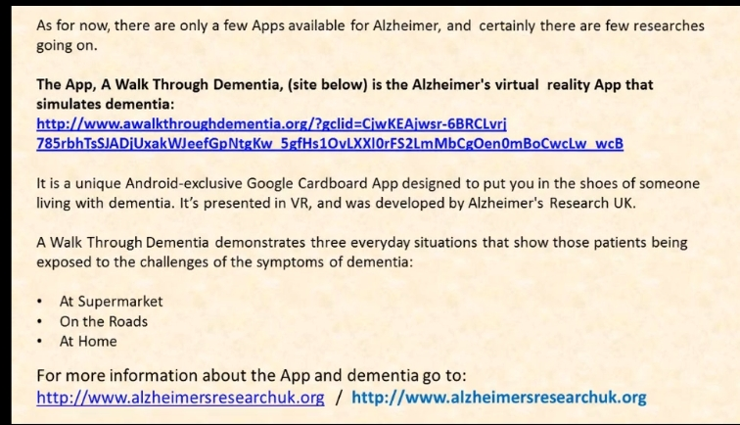
Vr therapY treatment for Alzheimer’s

Slide 14
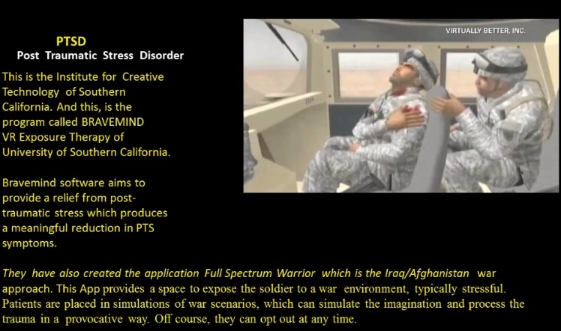
Post traumatic stress disorder

Slide 15
NHS Clinical trials of virtual reality for anxiety
£4 million project to make VR treatments available to NHS mental health services - Oxford Health NHS Foundation Trust

